Slide 1

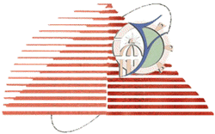
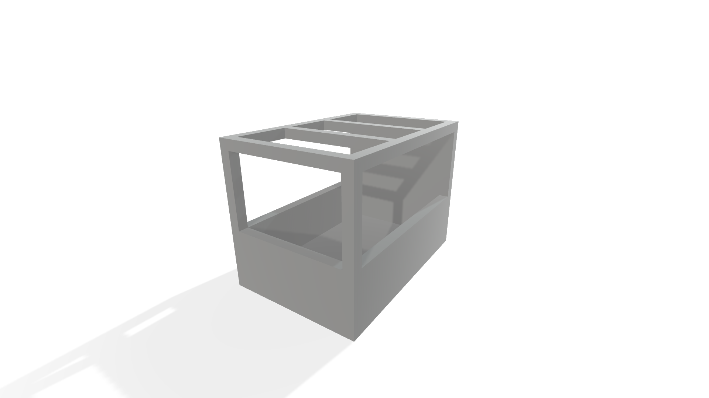
Smart Farming System
Students: Mahmoud Badr, Mazen Ahmed, Musa Mahmoud, Omar Mohamed, Mohamed Abdelaleem.
Supervisors: Dr. Ahmed Mustafa.
Department: Computers and Systems.
Fayoum university
Faculty of Engineering
Abstract
Objectives
Methodology
Results
Conclusion
Our project is a smart farming system that reads several agricultural sensors including a camera and feeds the data to a backend server. The server then saves the received data in a database for future reference and renders it to a website on which the farm owner can monitor his farm health. The owner will be notified if pests are detected using a computer vision model. The Farm will also have a timed watering system to limit water wastage.
The objective of the smart farming system is to create an automated and intelligent environment that optimizes plant growth and facilitates efficient agricultural practices. The system incorporates various components, including a soil moisture sensor, MCU (Microcontroller Unit), LDR sensor, water level floating switches, a camera, ML (Machine Learning) model, and a website. The soil moisture sensor provides real-time data on the plant's moisture level, allowing the MCU to determine if irrigation is required. The MCU controls the opening and closing of the valve and pump to provide precise and automated irrigation. The LDR sensor regulates the LED grid, providing tailored lighting conditions to support plant growth. The water level floating switches monitor the tank's state, automatically refilling it when empty and managing the tank's valve. The camera captures plant images, which are then sent to an ML model for disease detection and classification. Finally, the collected data and information are displayed on a website, providing users with valuable insights for monitoring and managing the smart farming system. The overall objective is to enhance crop health, optimize resource usage, and simplify decision-making processes for improved agricultural outcomes.
System Analysis and Planning: Analyze requirements and plan the development process.
System Design: Design the architecture and interconnections of system components.
Software Implementation: Develop firmware, machine learning models, and a website.
Component Integration: Connect and integrate the various system components.
Water Management: Monitor water levels and automate tank refilling.
Image Capture and Analysis: Capture plant images and analyze them for disease detection.
Data Display and Analysis: Develop a website or dashboard for real-time data visualization.
Testing and Optimization: Thoroughly test and optimize system functionality and performance.
Deployment and Monitoring: Deploy the system in a prototype and monitor its performance.
These steps ensure the successful implementation of a robust and reliable smart farming system that optimizes plant growth, resource usage, and disease management.
Enhanced Plant Health: Real-time moisture monitoring ensures optimal irrigation, promoting healthy plant growth, reducing disease risk, and increasing crop yield.
Efficient Resource Utilization: The LDR sensor adjusts the LED grid based on ambient light, optimizing lighting conditions and minimizing energy waste for efficient plant growth.
Effective Water Management: Water level floating switches and automated controls prevent water wastage, maintaining a consistent water supply without overfilling or depletion.
Disease Detection and Classification: Camera and ML model enable early disease detection, allowing timely intervention and minimizing crop losses.
Real-time Monitoring and Data Analysis: The website/dashboard provides instant access to crucial data, empowering farmers with insights for informed decision-making and efficient farm management.
Smart farming systems leverage advanced technologies like IoT and AI to revolutionize food production.
These systems help farmers optimize resource utilization, improve crop yields, reduce waste, and increase profitability.
Sensors and IoT devices are used to collect real-time data on environmental factors such as soil moisture, temperature, and humidity.
AI algorithms analyze the collected images to provide insights on crop health, disease outbreaks.
The information obtained from smart farming systems enables farmers to make more informed decisions regarding planting, watering, and harvesting.
Smart farming systems improve efficiency, sustainability, and profitability in the agriculture industry.
Continuous technological advancements are expected to bring about even more innovative solutions in the future, further enhancing the capabilities of smart farming systems.

